Slide 1



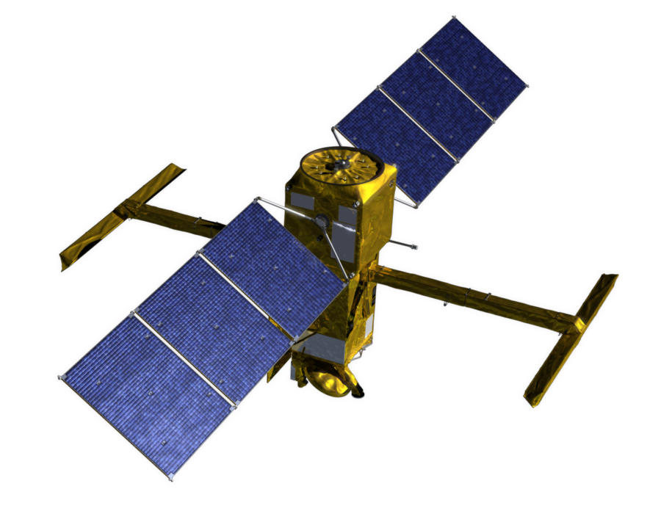


National Aeronautics and
Space Administration
Jet Propulsion Laboratory
California Institute of Technology
Pasadena, California
Surface Water and Ocean Topography (SWOT) Mission
HR ADT Meeting
2019 March 14-15
1 Introduction
Curtis Chen
This document has been reviewed and determined not to contain export controlled technical data.
Not for Public Release or Redistribution.

Slide 2
Logistics
Wi-Fi:
Network: eduroam (login of institution)
Network: JPLGuestInternet (password required as of Jan 2019)
Username = visitor email address provided for visit request
Password = visitor date of birth (MMDDYYYY)
Meeting will be in room 321-315 all day both days
Room 300-217 also available all day on Friday, March 15
Friday, March 15 is JPL Regular Day Off (RDO) for many personnel who have alternate Fridays off
Building 303 cafeteria will be closed (Building 167 cafeteria open)
Main JPL store will be closed
Visitors need to be escorted

Slide 3
Agenda and Objectives
High-level meeting themes:
Converging on product definitions in order to set targets for algorithm decisions and software implementation
Discussion of validation approaches, especially whether the data sets used for validation are realistic enough (and what to do if not)
Definition of relationships between river and lake processing
Coordinating path forward on joint algorithm work
Objectives are written in line with agenda topics
Intent is to record meeting outcomes on agenda as we go through meeting and establish concurrence of meeting participants as we go

Slide 4
Backup

Slide 5
Top-Level Algorithm Flow

Slide 6
KaRIn LR Algorithm Flow

Slide 7
KaRIn HR Flow

